Slide 1
Sole trade v Ltd company
Are you operating in the best way for you?
PRESENTED BY
RYAN DEMPSEY & GRANT COLLIER
INTEGRO ACCOUNTING
18th October 2023

Slide 2
Welcome! Today’s Agenda
Who are Integro Accounting?
Let’s find out about you – Visitor Poll
Recent changes
Day to day differences between Sole trader & Ltd
Financial differences between Sole trader & Ltd
Is Ltd Company or Sole Trader best for you?
Our limited time offer to IPSE members
Question & Answers

Slide 3
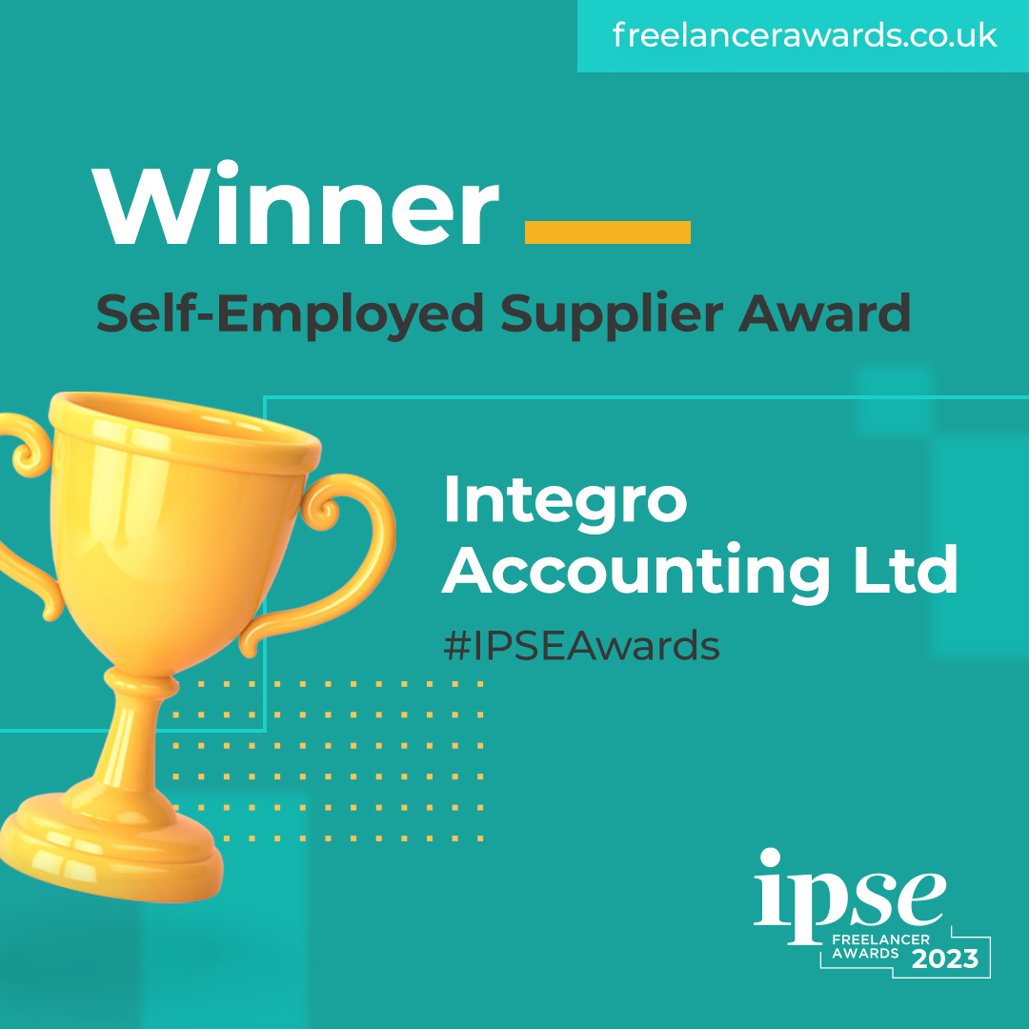
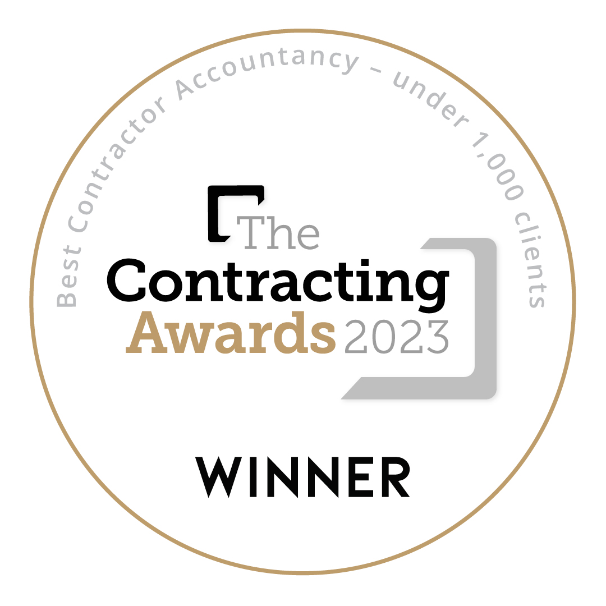
Who are Integro Accounting?
Recently crowned Self-Employed Supplier Award at the IPSE Freelancer Awards and Best Contractor Accountancy (under 1,000 clients) winner at The Contracting Awards 2023.
Specialist accountants to contractors, freelancers and small businesses.
Founded on the term ‘Integrity’ in 2013. Honest and trusted advice from a dedicated accountant –no trainees or call centre enquiries.
Clients from all over the UK, with our main offices in London, Cheltenham & Leighton Buzzard
Our team is made up of qualified & experienced accountants who have worked for some of the largest practices in the UK.

Slide 4
Let’s find out about you. . .
Working for yourself, are you trading as a sole trader, Limited Company, or class yourself as ‘other’?

Slide 5
Recent changes
Corporation tax
From 1st April 2023, the standard rate of corporation tax payable in the UK increased from 19% to 25%.
For smaller businesses with profits under £50,000, there is a small profits rate of 19%.
For businesses with profits between £50,000 -£250,000, you will pay a hybrid rate gradually increasing from 19% to 25%.
Businesses with a profit in excess of £250,000 will pay 25% on all profits.
Increased annual pension allowance
In April 2023, the standard annual allowance increased from £40,000 pa to £60,000.

Slide 6
Day to day differences
How quickly can you trade?
Filing requirements
Risks
Status & Responsibilities

Slide 7
How quickly can you trade?
Sole Trader
Can start work immediately, without having to register with HMRC until October following the tax year in which trading began.
You do not have to have a separate bank account to start trading.
Ltd Company
To trade through a Limited company, a separate legal entity must be registered with Companies House.
The company will need its own bank account.

Slide 8
Filing Requirements
Sole Trader
Self-assessment tax return
VAT returns x 4 if registered
Ltd Company
Annual accounts & corporation tax return
Confirmation statement
VAT returns x 4
Monthly PAYE RTI submissions + P11d
Self-assessment tax return

Slide 9
Risks
Sole Trader
As you and the business are one entity, any legal disputes will be taken against you and therefore your assets are at risk.
Ltd Company
As a separate entity, the directors and shareholders have limited liability.
This means that should there be any litigation, it would be taken up with the company and not you as the individual. Therefore, it is the company’s assets at risk.

Slide 10
Status & Responsibilities
Sole Trader
Less legal responsibilities compared to a Limited company.
Ltd Company
Specific responsibilities set out by Companies House for a director. Including acting in the best interest of the shareholders and behaving responsibly.
There is an element of a higher status or bigger business compared to Sole Traders which can lead to better opportunities, both for new work and finance/funding.

Slide 11
Financial Differences
Expenses
Tax rates
Tax planning

Slide 12
Expenses
Sole Trader
Wholly, exclusively & necessary for the business.
Any personal element to an expense would be disallowed for tax purposes.
Ltd Company
Wholly & exclusively for the business. Any personal element to an expense would be treated as a benefit in kind or income.
A main difference is that pension contributions can attract corporation tax relief.

Slide 13
Typical Expenses
Computer costs
Stationery
Travel & Accommodation
Use of home allowance (£10, £18 or £26 per month)
Insurance
Accountancy
Mobile phone
Annual event allowance*
Trivial benefits*
* More relevant to those with a Limited Company.

Slide 14
Tax Rates
Sole Trader
Personal allowance - 0%
Basic rate tax band - 20%
Higher rate tax band - 40%
Additional rate tax band - 45%
Ltd Company
Personal allowance & dividend allowance - 0%
Basic rate tax band (dividends) - 8.75%
Higher rate tax band (dividends) - 33.75%
Additional rate tax band (dividends) - 39.35%
Corporation tax paid on profits - between 19% -25%

Slide 15
NI Rates
Sole Trader
Class 2 & Class 4 NI
Class 2 - £3.45 per week
Class 4 - 9% on profits between £12,570 & £50,270 and 2% over £50,270
Ltd Company
NI is only paid on salary from Ltd company and not dividends taken.
If you plan well, no NI can be paid.
Employers NI - 13.8% over £9,100 and on all benefits.
Employees NI - 12% between £12,570 & £50,270. 2% over £50,270.

Slide 16
Take Home: Sole Trader vs Ltd
Sole Trader: Example 1
Self-employed profit £70,000
Income tax £15,432
NI £3,967
Take Home* £50,601
Sole Trader: Example 2
Self-employed profit £100,000
Income tax £27,432
NI £4,567
Take Home* £68,001
* Based on no expenses

Slide 17
Take Home: Sole Trader vs Ltd
Ltd Company: Example 1
Ltd Profit £70,000
Salary £12,570
Taxable Profit £57,430
Corporation Tax £11,469
Dividends £45,961
Tax on Dividends £5,999
Take Home** £52,532
Ltd Company: Example 2
Ltd Profit £100,000
Salary £12,570
Taxable Profit £87,430
Corporation Tax £19,419
Dividends £68,011
Tax on Dividends £13,441
Take Home** £67,140
**Based on extracting all profits as dividends, with no expenses or pension

Slide 18
Tax Planning Benefits for a Ltd Company
Whilst the benefits seen in a single year have been heavily reduced since the dividend tax changes in 2017, there are still many other advantages to using a Ltd company:
Pension contributions - will reduce your corporation tax. It may also lower the rate that you pay due to the variable rate between 19%-25%. Pensions for sole traders are pretax, so sole traders pay NIC on profits before pensions are considered.
Deferring personal income - Sole traders are taxed on profits in the year they are earned. For limited companies, corporation tax is paid on profits in the year they are earned, but you can plan your personal income from the limited company, limiting your personal pay to just below the higher rate tax band if you want to.
Investments - Opportunity to invest cash before paying higher rates of tax
Electric cars – company cars that are fully electric are deductible for corporation tax and only attract a small benefit in kind charge
Addition of partner/spouse as shareholder – if your partner/spouse helps with the business, you could make them a shareholder, making the limited company option more efficient.

Slide 19
Take Home Pay: Ltd with additional shareholder
What does this mean?
Additional responsibilities- your spouse would need to file a personal tax return each year.
Dividends would need to be paid into their bank account, not yours. Joint accounts are acceptable.
Limited Company: Example 3
Ltd Profit £100,000
Salary £12,570
Salary – spouse £9,900
Taxable profit £77,530
Corporation Tax £16,795
Dividends – 70/30 split £60,735
Tax on Dividend £6,109
Take Home** £77,096
**Based on extracting all profits as dividends, with no expenses or pension

Slide 20
Is Ltd Company or Sole Trader best for you? Let Grant tell you. . .
The decision is unique to you & your circumstances.
There are many variables to consider such as:
Opportunity to utilise partner or spouse’s allowances as employee & shareholder
Budgeting needs for personal income
Future planning & exit strategy
Length of time you are planning to trade
We can offer a free, no obligation 1:1 consultation tailored to your exact circumstances to find the best route for you.

Slide 21
Get in Touch
Grant Collier grant@integroaccounting.com 0207 096 2659
Ryan Dempsey ryan@integroaccounting.com
0207 096 2659

Slide 22
Limited Time Special Offer for IPSE Members
Sign up to one of our fixed fee packages.
First 2 months accountancy service completely free!
Quote or choose ‘IPSE Webinar’ to take advantage of this offer and get started.
Book a FREE consultation or call 0207 096 2659.

Slide 23
Question & Answer Session

